Slide 1
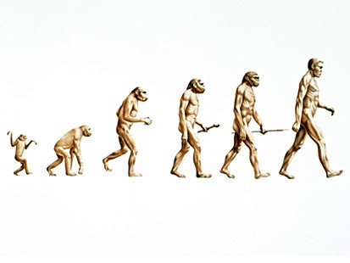
EVOLUTION OF DESIGN STRATEGY

Slide 2
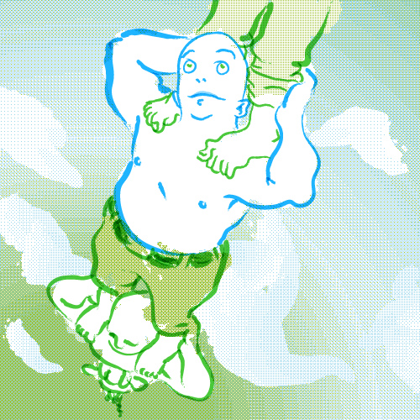
“STANDING ON THE SHOULDERS OF GIANTS”
Sound Familiar?
It is a modest quote from sir Isaac Newton in relation to how he made further progress in science by building on the work of others.
Many new designs for products are rarely original. They may look original, but when they are broken down you can see that they are just evolutions of previous designs (an improvement on another design)

Slide 3
HOW DOES THIS HELP US?
All too often Leaving Cert projects that pupils make are copies of designs on the market or the class may all have similar designs to one another.
This technique may help you come up with your own “original” design.
First, lets take a look at the most common examples of this in today’s design technology: the mobile phone and the car

Slide 4
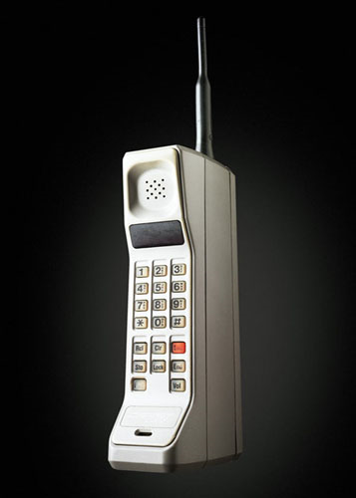
The original mobile phone
TALK
TEXT

Slide 5
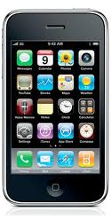
THE MODERN MOBILE PHONE
Colour
Call
Apps
Text
Bluetooth
Camera/video
Music player
Games
Radio
Internet

Slide 6
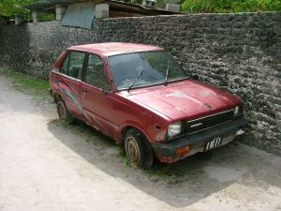
The basic car
Gets you from A to B

Slide 7
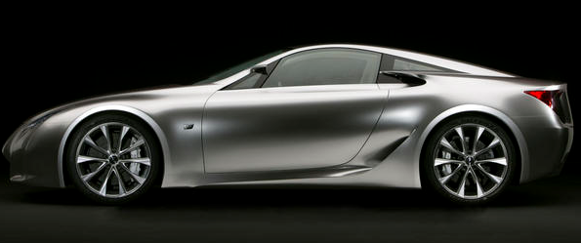
THE MODERN CAR
Layered Paint
Aerodynamic
Built in computer
Hybrid
Rear/side view cameras
Alloy wheels
Leather interior
Anti-flat tyres
Air-con

Slide 8
The Basic Principle to follow
Adapt?
Modify?
Substitute?
Magnify?
Minimise?
Rearrange?
Combine?
Lets look at some examples!

Slide 9
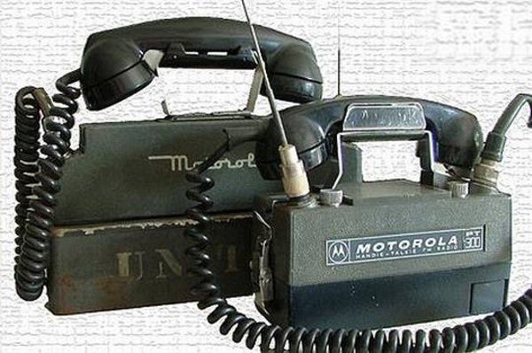

Adaption
Certain products and designs need to adapt in order to meet demand:
Mobile Phones needed to adapt their design in order to become easier to use and carry.

Slide 10
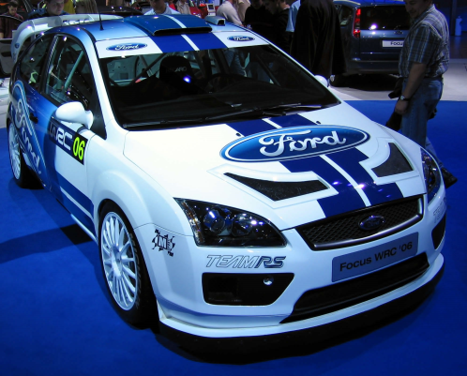
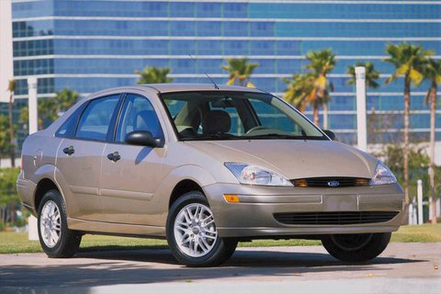
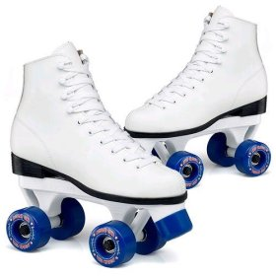
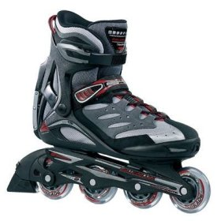
Modify
Designs can be modified to suit the context they are used in or to improve their function

Slide 11


Substitute
Sometimes designers substitute a part of a design with something else. In this case the same vehicle design is used except the loader is substituted with front forks.

Slide 12
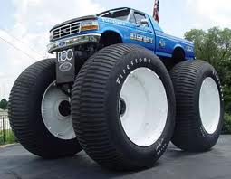
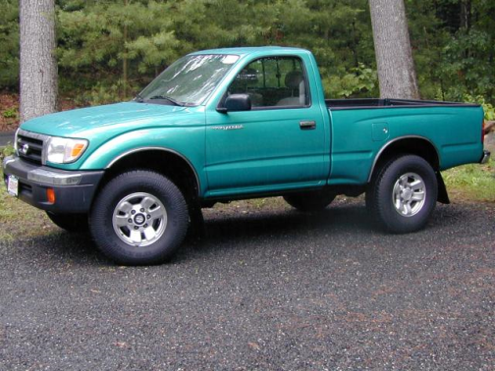


Magnify
(Hair Curlers)
Aspects of a design, or the entire design, can be magnified to suit its use or improve its function.

Slide 13
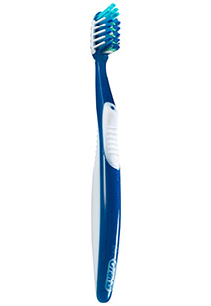

Minimise
Designers sometimes find a way to minimise a design in order for it to perform a certain function such as a travel toothbrush.

Slide 14



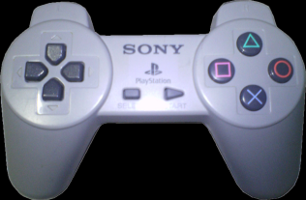
Rearrange
Sometimes designers rearrange designs possibly to make it look more appealing or easier to use

Slide 15
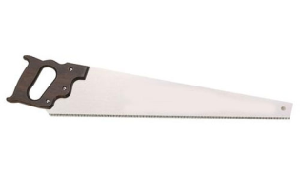
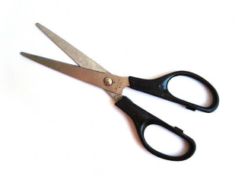
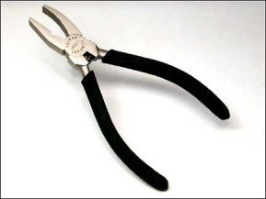
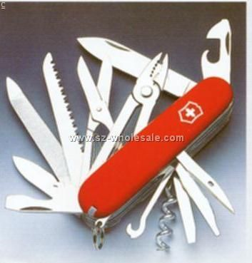
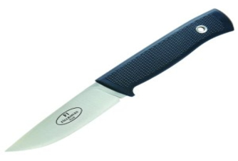
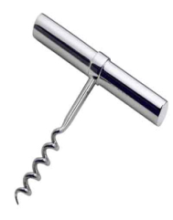
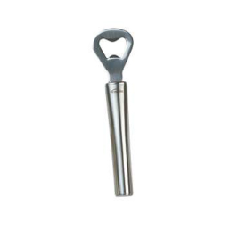
Combine
The Swiss army knife is the perfect example of how many designs are combined into one design.

Slide 16
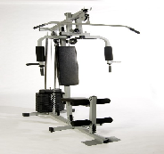
Activity
The home multi-gym (pictured) is a common product that has various versions on the market.
Use parts of (or all of) the Design Evolution Strategy to come up with your own version multi-gym.
State clearly what part of the Design evolution strategy influenced you in the design of each aspect.

